Slide 1
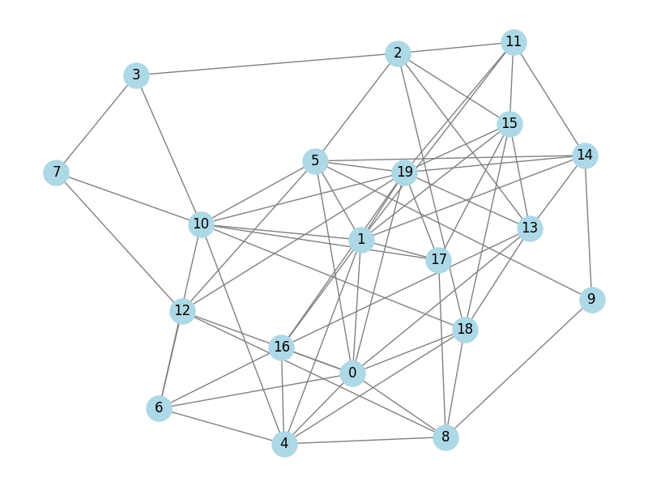
Team 20: Disinformation Spreaders
Modelling the spread of disinformation in social networks.
Notes:
Boyu - 25s
Good afternoon. We are Team 19, the disinformation spreaders, and we’ll talk about how disinformation spreads in social networks.

Slide 2
Table of Contents
Introducing the topic of disinformation
Reference paper
Topologies of interest
The extended Ising model & example simulations
Experiment 1
Experiment 2
Experiment 3
Conclusion
Appendix
Questions
Notes:
Boyu -25s
Let me briefly outline the structure of our presentation. First, we motivate the problem of disinformation and introduce our Ising-based model. We then study how memory, external influence, and network topology shape opinion dynamics. Finally, we present our main results and conclusions.

Slide 3
How do social networks respond to external stimuli and how robust are our beliefs?
In recent years, disinformation, misinformation, and fake news are becoming an increasingly pressing issue, spread by social media and artificial intelligence generators.
This project aimed to investigate the sudden transition characteristics from neutrality or consensus to bimodal polarisation to draw conclusions about disinformation spread in social networks.
Notes:
Boyu -
Nowadays, the spread of disinformation, misinformation, and fake news has become a major challenge, especially due to social media and AI-generated content.
This spread also leads to the polarisation of political views, increasing the risk of political instability and reduce social cohesion. For instance, during recent U.S. elections, Russian narratives surrounding Donald Trump were amplified within online communities, which illustrate how external information can shape collective beliefs.
In this project, we focus on understanding when and why such transitions occur, and what determines how robust collective beliefs are against external influence in social networks.

Slide 4
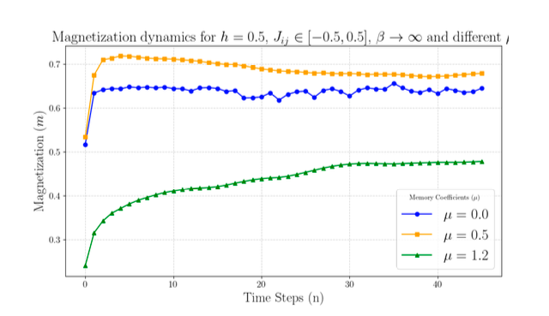
Modeling Disinformation Spread in Social Networks: Phase Transitions and Mean-Field Analysis (Evangelatos 2025)
Introduces statistical mechanics models to understand the spread of disinformation.
Magnetization in “three-state Ising model”
Heterogeneous coupling strength.
Static, external field of influence
Inverse temperature β
Memory coefficient μ and the idea of cognitive inertia.
(Finding) Higher memory coefficient reduce belief shifts, reinforcing polarization and undermining counter-disinformation efforts.
Limitations and assumptions of the model:
Goldfish population
Simplified belief modeling (could have many more states)
Time independent (static) external field -> Our addition: Dynamic external field
Assumption of a rational influence
No latency in the processing of infromation
Notes:
Oskar:
Since this project is more of a sprint than a marathon, we chose the paper from the title as a baseline paper to reproduce and extend later on in the project.
It studies disinformation spread in a social network represented in the form of a three-state Ising model, where each node can reject, adopt, or be on the fence about a piece of disinformation.
The underlying weighted undirected graph allows nodes to interact between each other, where nodes pull on their neighbours to adapt the same belief if the weight is positive. These coupling strengths are heterogeneous to represent the differences of depth in social ties, and negative strengths will promote disagreement. External influences on belief in a social network, such as targeted disinformation campaigns, propaganda or fact-checking efforts, are combined and represented by an external field that nudges the transitions into specific directions.
An interesting and novel addition the paper offers, is the introduction of memory effects, where the prior belief of a node influences the probability of it adapting a different belief, called cognitive inertia.
Evangelatos et al found that the addition of memory effects did affect the shifting of belief in a network, where a higher memory coefficient reduced the rate at which belief changes, but apparently also account for higher measures of polarisation. These findings are aligned with real-world scenarios, where strongly based prior beliefs result in less pliability of opinion.
This paper introduces a necessary extension to existing belief frameworks, but still lacks certain aspects of the complex idea of social interaction and information sharing.
One of these problems is the fact that any nodes memory only lasts for a singular timestep. This assumption that yesterday’s belief influences today’s belief feels like a valid design choice, but yesterday’s belief “disappearing” tomorrow shows the “goldfish-like” memory of the model.
Another aspect in which the model is limited would be the ternary representation of belief. There are far more possibilities than agreeing, disagreeing and not being sure, but the options are not present in this research.
Another limitation is the assumption of rational influence which overlooks the emotions that play into decision-making.
This paper also assumed zero latency of the information spread, whereas in reality individuals process and digest information/news with a delay. A missing ingredient we wanted to explore was the lack of a temporal aspect in the external field. Since information events such as campaigns, breaking news and propaganda don’t slowly and statically pull on a networks belief, we decided to extend Evangelatos’ model with a per-node temporally dynamic representation of external influences, which lets us nudge a fraction of the population towards a belief during a specific time interval.

Slide 5
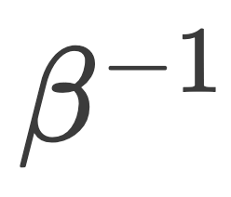

Research question and hypotheses
RQ: How do propaganda events alter the critical threshold at which a social network transitions to a different belief state?
H1:There exists a temperature threshold dividing order and chaos states.
H2: The Scale-Free networks are less resilient to propaganda events than Small-World or Erdos-Renyi.
H3: Increase in cognitive inertia leads to 1) a decrease in adoption of disinformation after a propaganda event and 2) increased resilience of the network.
Notes:
Oskar
So, what do we want to do with all of this? We have mentioned the “dynamic external field” which allows us to model time-sensitive disinformation spread. With this, it is natural for us to explore this extra degree of freedom with our research question. This has led to the concept of “propaganda events” which we will define a bit later, and finally the overall question
How do propaganda events alter the critical threshold at which a social network transitions to a different belief state
We explore this question with three hypotheses, the first of which is a preliminary to run good experiments and to generate a nice plot that the reference paper does not provide. This is hypothesis one, the details of the outcome of which informs the remaining experiments. With the next hypothesis, we want to explore how and whether the specific connectedness of the network affects the resilience against spread of false information. We suspect that networks with the scale-free topology are least resilient based off an experiment in the reference paper, in which they showed that this topology adopts new information most quickly.
The third and final hypothesis explores the memory parameter µ, where we’d expect a population with cognitive inertia to remain more resilient to propaganda events but more research would be needed.
grading criteria:
link hypotheses to motivation

Slide 6


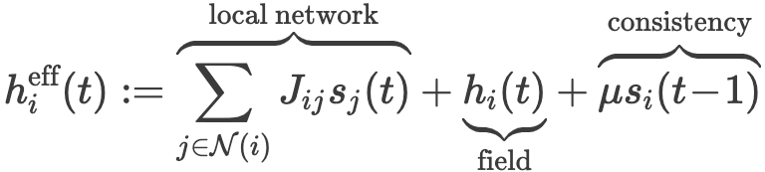


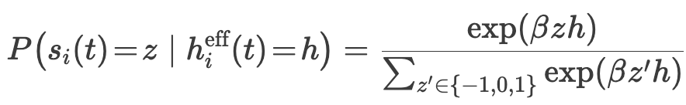


The extended Ising model
* also known as the Potts model
*
Implemented using JAX for efficiency
Notes:
Theo:
Let’s spend a moment together to understand the model we are simulating.
The state of each node at time t, which is one of three values, is denoted s_i of t.
The bond strengths or coupling strengths between nodes i and j are denotes J_ij, and we have that J_ij = J_ji because the graph is undirected. Our addition is the time-dependent external field h_i(t), which, due to the “i” subscript, is also in a sense personalized per node “i”.
With these quantities, it will be useful to define, as they also do in the paper, the “effective field” for node “i”, which is a sum of the neighboring states weighted by the bond strengths, with the temporal personal field added to it. The final term is the cognitive inertia term, which promotes old beliefs to remain, explicitly modeled as the state of node “i” at the previous timestep. The parameter mu (µ) is nonnegative and we will refer to it as the memory coefficient.
Finally, with these definitions out the way, we can define the transition dynamics of the network:
The probability of transitioning to state “z” can be computed by knowing the effective field, which, after which it is a boltzmann-type distribution with inverse temperature parameter beta. Since z and h interact multiplicatively, the energy is minimized when they have the same sign, which promotes a new state that agrees with the effective field over one that disagrees. So in spirit it is very similar to the ising model, but no longer on a grid, with edge weights, with a self-consistency tendency, and with an external field “h” that lets us interact with the system and poke it.

Slide 7
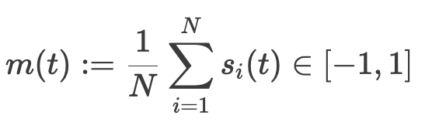
Magnetisation
Magnetization (m) - our primary metric for quantifying global alignment of beliefs, representing the overall tendency to adopt or reject disinformation.
m = -1: Universal rejection. The entire population maintains the initial belief
m = +1: Universal adoption. The entire population has adopted the propaganda.
Notes:
Theo:
To quantify the collective outcome of opinion dynamics, we use magnetization as our main observable.
Magnetization is simply the average opinion across all individuals in the network. It range from -1 to 1. A value of -1 corresponds to universal rejection of the propaganda, while +1 indicates full adoption.
Throughout the rest of the presentation, magnetization will be our key measure for determining whether external influence succeeds or fails.

Slide 8
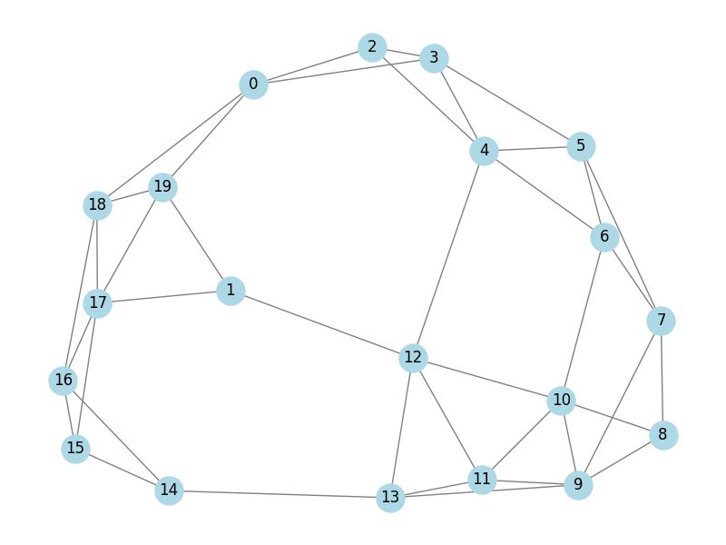
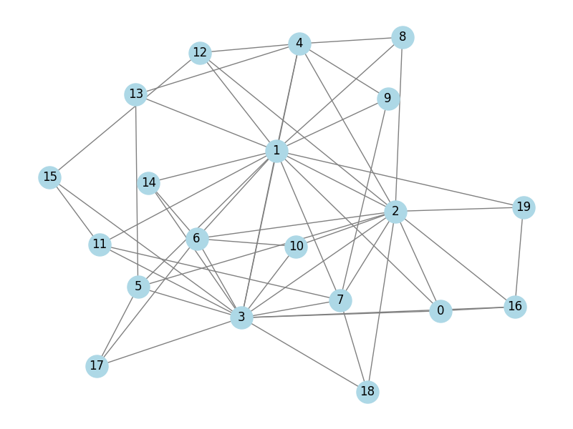
Topologies of interest
Erdos-Renyi
Small-world
Scale-free
Notes:
Boyu
We consider three different network topologies to model social interactions.
First, Erdos-Renyi networks, where connections are random and homogeneous.
Second small-world networks, which capture high clustering and short path lengths, typical of real social networks.
And third, scale-free networks, characterized by hubs – a few highly connected individuals with disproportionate influence.
By comparing these topologies, we can study how network structure affects the spread of disinformation and the robustness of collective beliefs.
We will only be studying networks of size 100 with an expected amount of around 990 edges when it is possible to control the edge count.

Slide 9
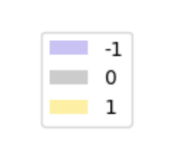
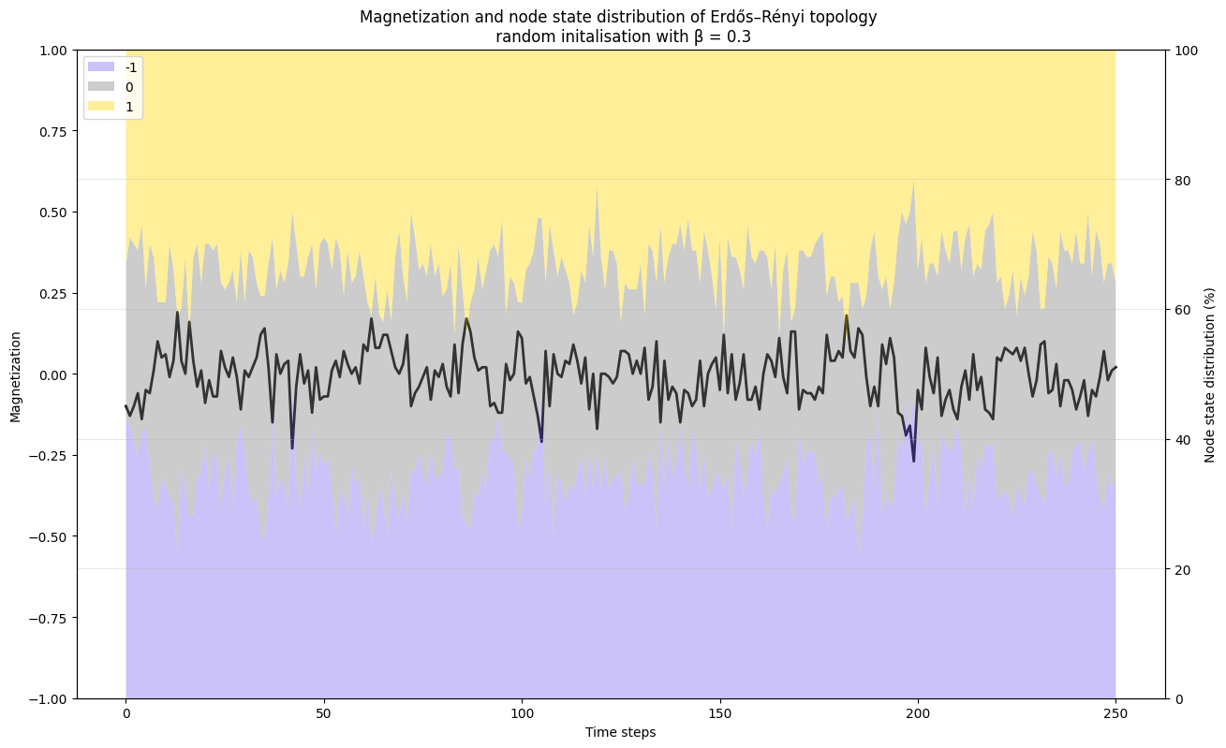
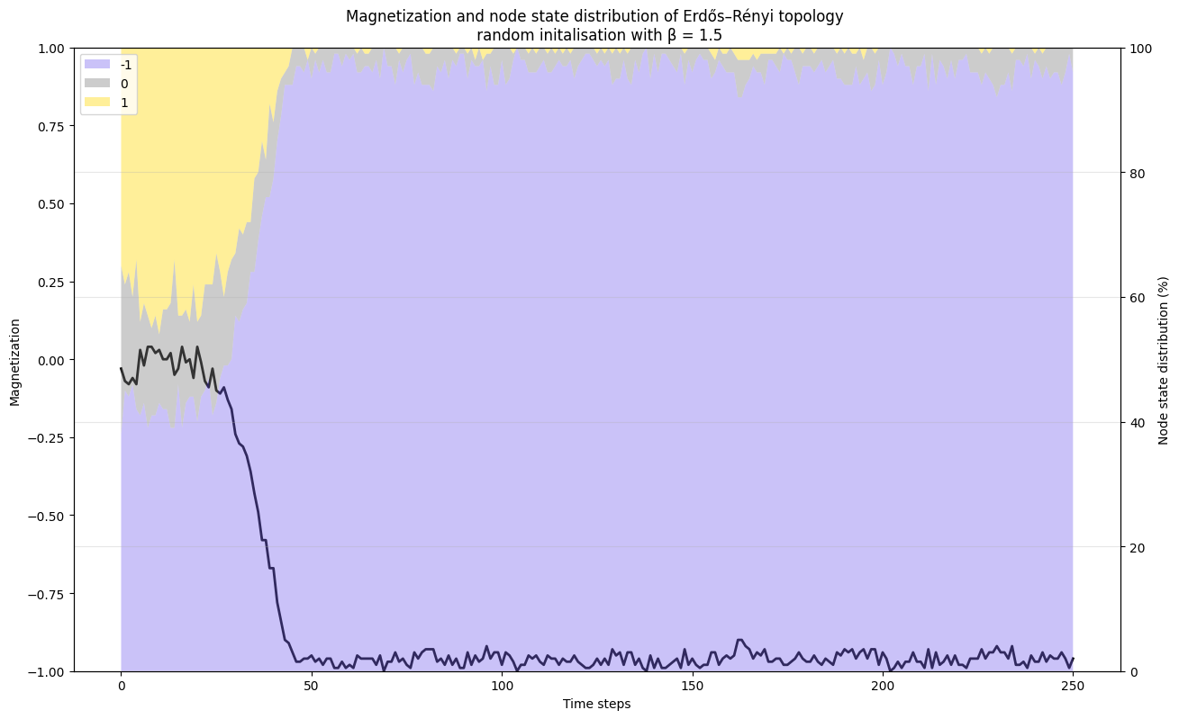
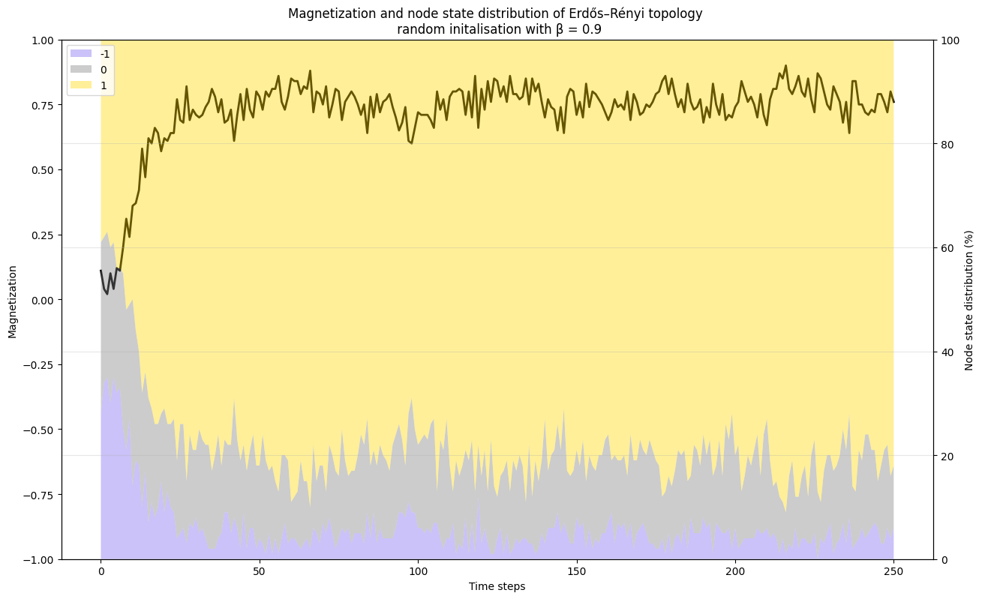
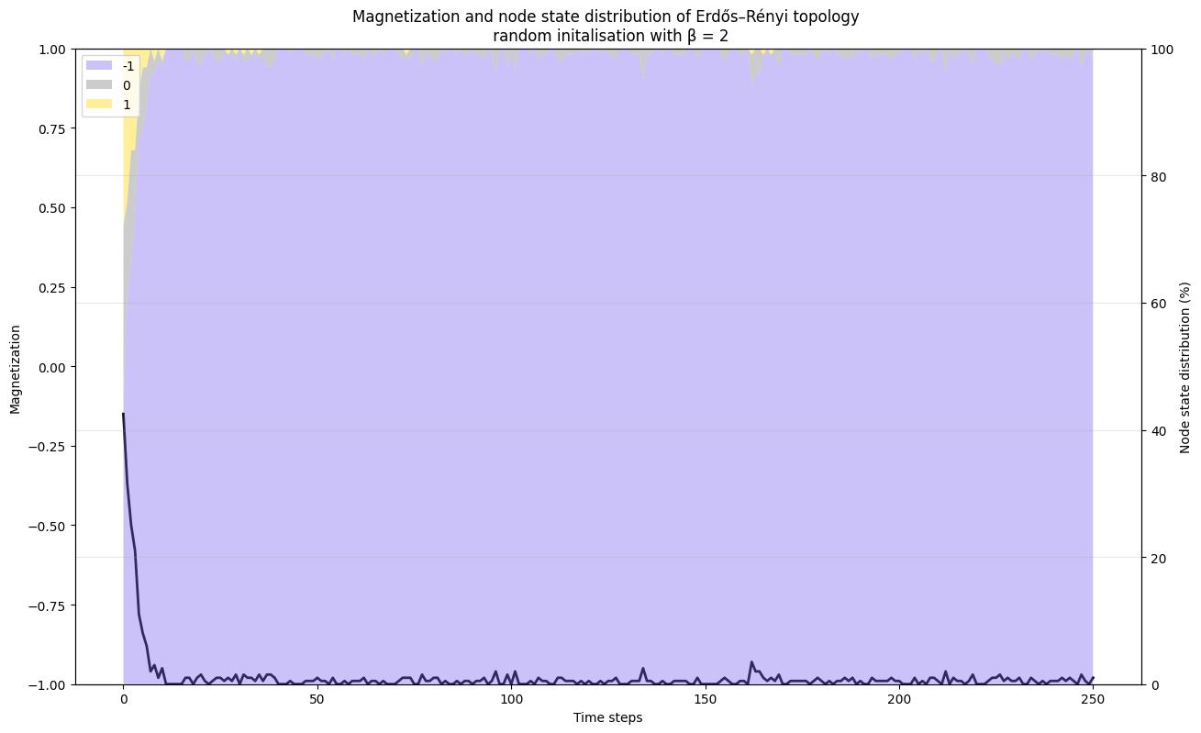
Example trajectories of the model
background shows the percentage of nodes in each belief state
Model with random state initialisation and no external field for different values of β.
State of chaos, uniform distribution of states
Low/Med. Temp, β=1.5
High Temp, β=0.3
Very high average magnetisation - one view will be completely adopted
Low Temp, β=2
High / Med. Temp, β=0.9
Patterns emerge
Notes:
Boyu
Here we show example time trajectories of the magnetization for the model, starting from the random initial conditions and without any external field.
Each panel corresponds to a different value of the inverse temperature β, which controls how noisy the dynamics are. The background colors, purple, grey, and yellow, show the distribution of the three different states, with purple being -1, grey being 0, and yellow being +1.
At low β, meaning high temperature, the dynamics are noise-dominated: opinions fluctuate strongly and the magnetization remains close to zero.
As β increases, the system becomes more stable and self-organized consensus starts to emerge.
For very large β, the dynamics are almost deterministic and the system rapidly converges to a fully ordered state.
At low β, corresponding to high temperatures, the system is dominated by noise: opinions fluctuate strongly, and the magnetization stays close to zero, indicating a disordered or chaotic state. We see that we have a pretty even ⅓ split between all states at all times.
As we lower the temperature (lower left image), the dynamics become more stable, and we begin to see self-organized consensus, where the system converges to a state with high magnetization. Only a few neutral nodes remain and even fewer of the opposing view.
For very larger β, meaning even lower temperatures, this alignment becomes almost deterministic: the system rapidly settles into a fully ordered state, where nearly all agents share the same opinion.
These trajectories illustrate the transition from disordered to ordered collective behavior as noise is reduced, even in the absence of external influence, meaning, in these simulations the external field was zero.

Slide 10
Example trajectories of the model
background shows the percentage of nodes in each belief state
Model with random state initialisation and no external field for different values of β.
State of chaos, uniform distribution of states
High Temp, β=0.3
High / Med. Temp, β=0.9
Patterns emerge
Inverse temperature β - controls the ‘noisiness’ of the dynamics
Notes:
Boyu
Here we show example trajectories of the mean magnetization. They start with random initial conditions and without any external field.
On the left we have low β, meaning high temperature - the dynamics are noise-dominated: opinions fluctuate a lot but remain close to zero.
On the right, as β increases, the system becomes more stable and self-organized consensus starts to emerge.
The background colors, purple, grey, and yellow, show the distribution of the three different states.

Slide 11
H1: There exists a temperature threshold dividing order and chaos states.
Initial State: System starts in a uniformly distributed random state.
Memory parameter: µ = 1 - all nodes listen to past self as much as any neighbor.
Question: How do the steady states of the system evolve as we vary the temperature parameter? In what range can we expect to see patterns?
Notes:
Boyu
Our first hypothesis is to investigate whether a specific tipping point exists that triggers the network to exhibit structured behavior. Our first hypothesis suggests that there is a specific inverse temperature (beta) threshold which divides the stable and chaos states.

Slide 12
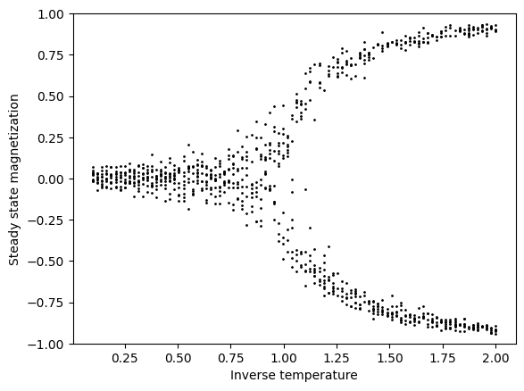
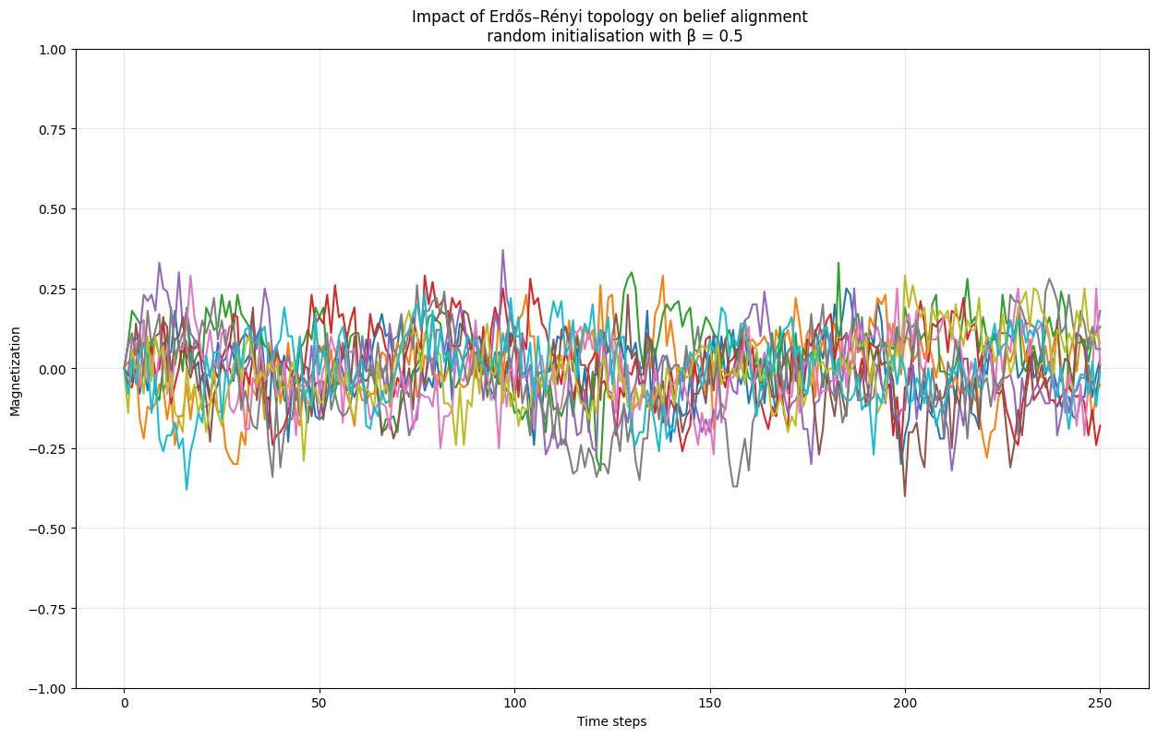
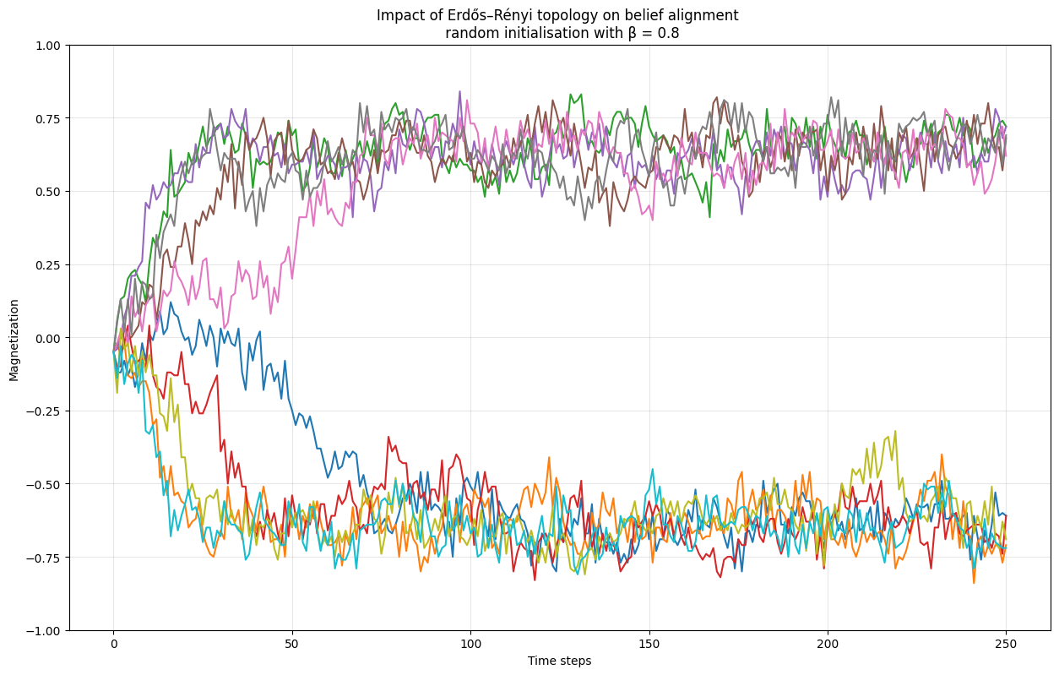
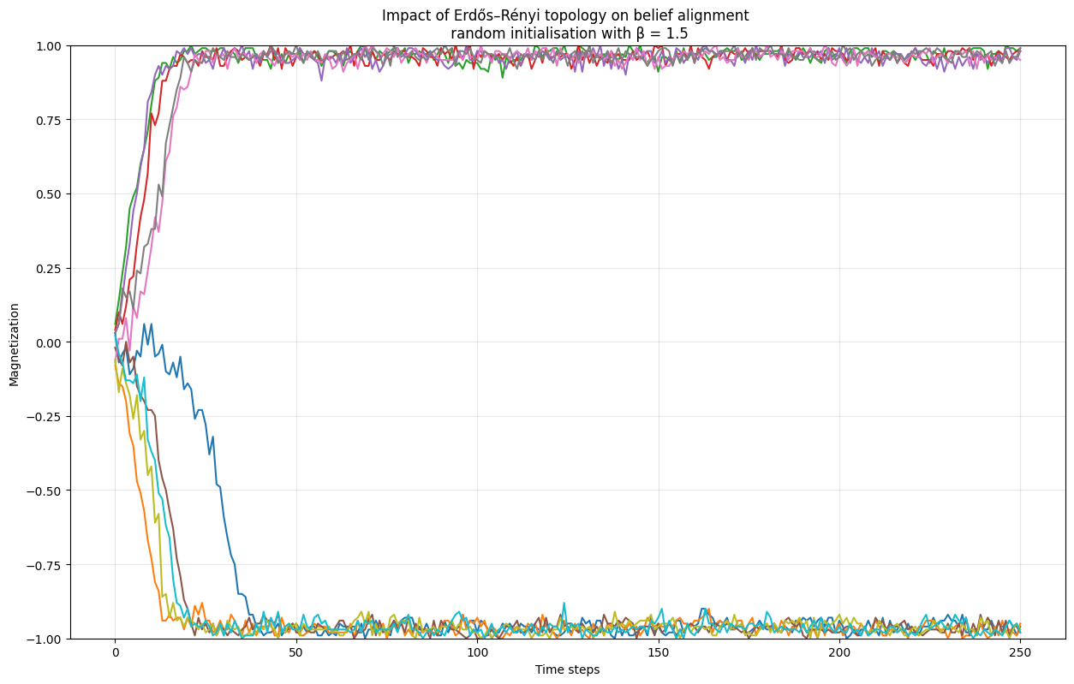
Erdos topology
≈ 0.75
10 simulations per temperature
Results:
Disorganized region
High temperature “chaos soup”
Low temperature order
Notes:
Theo Here is the resulting figure we generated. Each black dot represents a single simulation run for 250 timesteps, after which we report the average magnetization. For each temperature, we run ten independent simulations. We see a clear bifurcation-like picture here. It shows that, as we decrease the temperature parameter, which means increasing the inverse temperature, moving to the right, the system is suddenly able to settle into one of two steady states. Although there is a lot of noise in this image, we can think of this splitting happening around 0.75, which is an easy number to remember that we will encounter again a bit later, which is worth remembering.
Here are some full example trajectories of the magnetization.
This leftmost end is the high temperature region, which we also saw two slides ago. We expect a uniform distribution of all three states, resulting in a mean magnetization around zero. In the vicinity of 0.75, we get behaviour that does a bit of random walk but eventually settles into one of the two attracting basins, seen here on the figure.
If we decrease the temperature further (reduce the randomness), the system quickly falls into one of the two basins and there are less jumps and wandering in each individual trajectory.

Slide 13
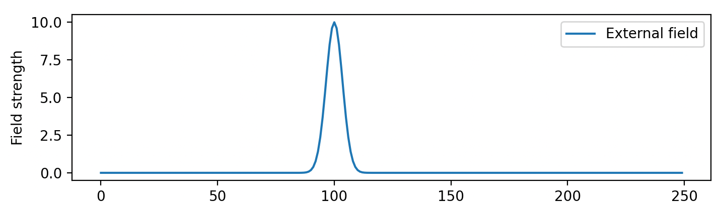

H2: For a given size, the topology of the network influences belief spread.
Propaganda event: Some individuals are exposed to a strong belief for a duration.
Initial State: System starts in total consensus - all nodes have the negative belief (absence of disinformation).
Memory parameter: µ = 1 - listen to past self as much as any neighbor.
Number of nodes: 100
Question: What fraction of people need to be affected by the field for the consensus to shift from the initial -1 into +1?
Notes:
Alicja
Now we move on to hypothesis two. As a preliminary for this, we now make use of the dynamic and time-dependent external field that we have introduced to the model. Remember that the field is a force that will affect the transition probabilities of a node. We will now model a propaganda event by a gaussian pulse function (see slide). Here, we set it up such that there is effectively no field until we get to the proximity of timestep 100, at which a strong spike is affecting some fraction of the population, which pushes strongly in the +1 (“plus one”) direction for a few timesteps, after which it decays again. By isolating the event in time, we get to study the before and after behaviour of the network. As we will initiate the full network in the state -1, meaning absence of disinformation, this means that the propaganda will pull them towards the disinformation state.
We also need to set the memory coefficient µ (mu). For this experiment, we set it equal to one, which means that each individuals past beliefs are as influential as that of their neighbours. What we are interested in is now, what fraction of people is needed to be affected by the field, for the consensus to shift from the initial -1 to +1, and how does the temperature parameter influence this?

Slide 14
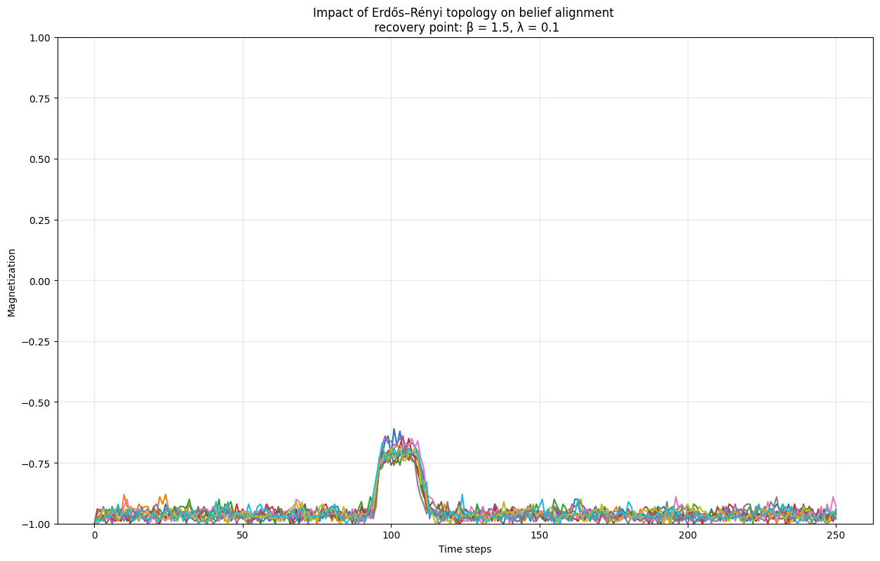

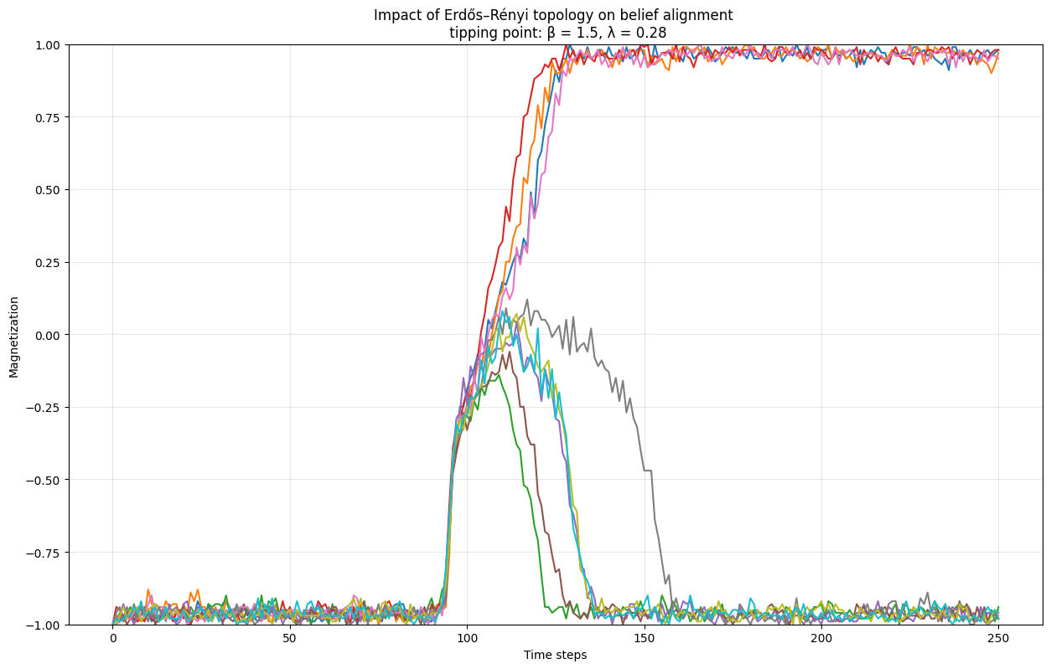
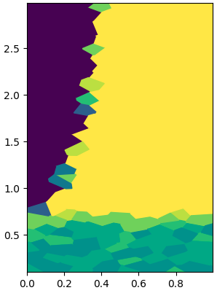
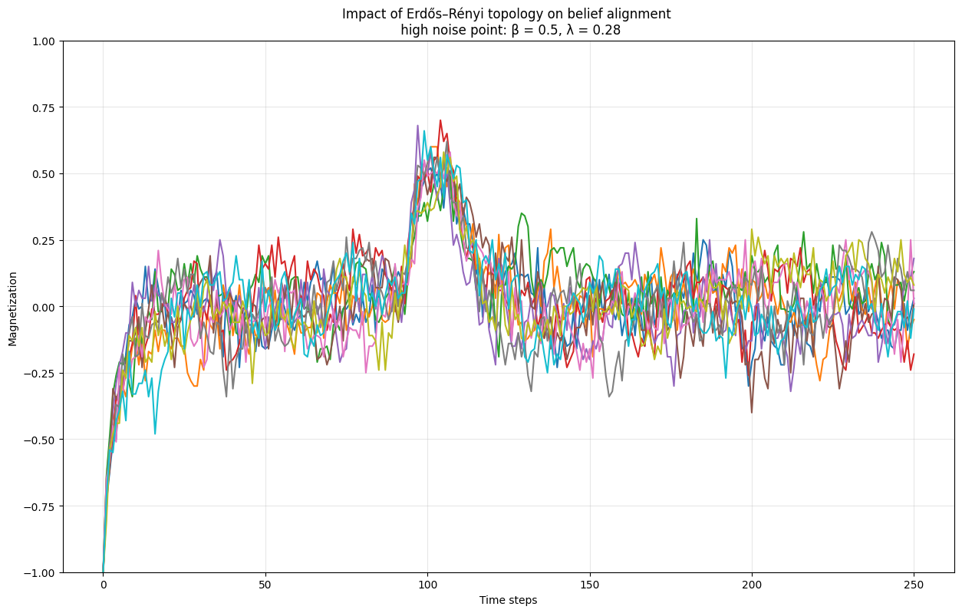
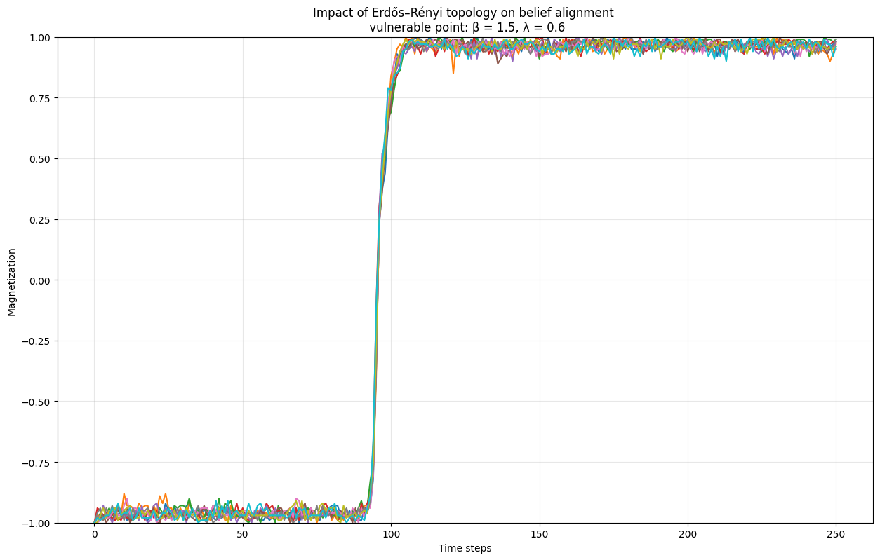


Erdos-Renyi
25 repetitions per cell to reduce variance.
β
Tipping point
Recovery point
≈ 0.75
High-noise point
Vulnerable point
Notes:
Alicja:
For each pair of parameters (fraction and temperature), we run the simulation a few times, and compute the empirical probability of disinformation taking over the network (at time step 250). We plot the results using Voronoi diagrams to support varying resolutions. Each cell color is determined by 25 repetitions to reduce variance and thus achieve a more robust and reliable result. This graph allowed us to identify 4 behaviours of the network. The darkest blue region we name the “recovery region”, in which the consensus remains in the negative belief state after the propaganda event. Here are a few trajectories showing how the average magnetization evolves. We see that the network is comfortably in the negative state, then is affected by the event, but easily recovers. The lowest green region in the “high noise” or “high-temperature” area. If you recall the first hypothesis with the bifurcation plot, we identified a threshold of about 0.75, below which the network was no longer able to minimize the energy. This is also reflected in this figure, where the color green corresponds to an equal probability of ending in positive and negative magnetization, which is a characteristic of random behaviour. The plot of sample trajectories for these parameters shows how noisy the dynamics are. Even before the propaganda event, the network is not able to maintain the initial negative state and drifts into a mean zero belief, which is also what it returns to after the event. This region simply has a too high temperature for interesting behaviour. The last region, in yellow, which we call the vulnerable region, is the one where the system is highly susceptible to propaganda events and is almost guaranteed to adopt it. From the entire upper right part being yellow, we can draw the following conclusion: Assuming a low enough temperature (so we’re in the upper region of the plot), a high enough fraction of the population being exposed to the event will always lead to vulnerability. On the bottom right we can see some example trajectories from this point. We see that the propaganda event easily sends the entire network into the opposing state.
A final very interesting point is the transition from the recovery region to the vulnerability region, right on the edge between the two. This tipping point captures a critical balance between the two forces. This state is very sensitive to the state of the network and it can go either way. This tipping point is the deciding threshold that characterizes this phase transition from stable to unstable. This study was conducted on the Erdos-Renyi network, and next we inspect how this diagram changes as we change the topology of the network but keep the number of nodes (which in this case was 100) the same.

Slide 15
Crossing the tipping point
20 trajectories initialised with the same seed
GIF available in the results/erdos_renyi_individual.gif
Increasing the fraction of the population exposed
Notes:
Alicja:
This transition from the recovery region to the vulnerable region is interesting in its own right, so we want to visualize it for you. We are sweeping the parameter space along the red arrow, from the recovery region to the yellow vulnerable region. Throughout, we will show 10 full trajectories of how the magnetization changes over time, before and after the propaganda event. As you see, the tipping point is characterized by very diverse behaviour, making it hard to predict the final state of the network in its vicinity.
We are using the same seed for the 10 trajectories, which is why you won’t see them vary across parameters until during and after the event.

Slide 16
Crossing the tipping point
GIF available in the results/erdos_renyi_lambda_sweep.gif
Same simulation with mean trajectories and variance
Notes:
Alicja:
Next up we show basically the same figure, but we plot the average of the trajectory plus minus one standard deviation to show how, close to the tipping point, the diversity of the trajectories greatly increases. We are making absolutely no claim that the trajectories will be normally distributed here, this is just another way to show variation. Anyway, let’s move on the different topologies and repeat the experiment.

Slide 17
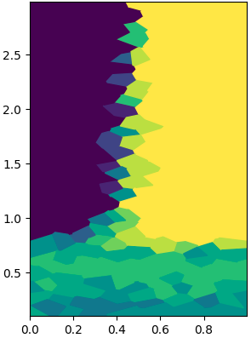
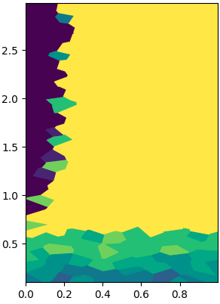
H2: For a given size, the topology of the network influences belief spread.
Erdos-Renyi
Small-World
Scale-Free
Findings: the transition between regions happen at different values of temperature and fraction of population exposed to the propaganda.
Notes:
Alicja: So here we have the results for all three network topologies in the study. The first is the picture we saw before, associated with the Erdos-Renyi model. Next we show the small-world and scale-free results. The main immediate change is the size of the dark region, the “recovery region”. It is maximal in the small-world figure, and the smallest in the scale-free network. Since the recovery region is associated with a resilience to change, we see that the small-world network is maximally resistant among the three, while the scale-free one is most susceptible.
Another observation is the temperature threshold. We see that it is similar for the first two topologies, but lower for the scale-free network. Effectively this means that the scale-free networks can sustain higher temperature parameters before succumbing to random behaviour. More on that on the next slide.

Slide 18
H2: For a given size, the topology of the network influences belief spread.
Erdos-Renyi
Small-World
Scale-Free
Findings: the transition between regions happen at different values of temperature and fraction of population exposed to the propaganda.
Notes:
Alicja:
different region sizes
· temperature threshold lower for scale-free - similar for the first two topologies, but lower for the scale-free network (can sustain higher temperature parameters before moving to random behaviour)

Slide 19
H2: For a given size, the topology of the network influences belief spread.
Erdos-Renyi
Small-World
Scale-Free
Findings: the transition between regions happen at different values of temperature and fraction of population exposed to the propaganda.
Notes:
Alicja:
different region sizes
temperature threshold lower for scale-free - similar for the first two topologies, but lower for the scale-free network (can sustain higher temperature parameters before moving to random behaviour)

Slide 20
Based on the Voronoi graphs for the 3 topologies, and saw that the system transitions into a different state at differing values of beta and lambda.
Tipping point for the same inverse temperature (β) all happens at different values of population fraction (λ) for each topology:
Behavior | Erdős–Rényi (β,λ) | Small-World (β,λ) | Scale-Free (β,λ)
Tipping point | (1.5, 0.28) | (1.5, 0.50) | (1.5, 0.15)
 | Moderate susceptibility | Highly resilient | Vulnerable
error ≈ the radius of the voronoi cell size
This confirms the second hypothesis:
H2: For a given size, the topology of the network influences belief spread.
Scale-free reaches the tipping point at the lowest lambda - meaning this network topology is least resistant to the disinformation.
Notes:
Alicja:
From the previous diagrams we can extract more quantitatively the tipping point, which we define as the fraction of the population (which we denote as lambda) that can be affected by propaganda which leads to a 50% chance of tipping. To facilitate comparison, for a fixed inverse temperature of 1.5 (which is safely beyond the chaotic threshold), we show the tipping points, which are .28, .15, and 0.5 respectively. With 10 repetitions to estimate each tipping probability, we have high confidence in the ranking of these.
It is interesting to note the small-world network further. The estimate of the tipping point of 0.5, highlighted in the middle, (which has an error magnitude around the radius of the voronoi cell size) is indicative that the small-world works a lot like a majority vote and tips only when the majority is reached. The small world networks are characterised by high local clustering - this clustering means that nodes primarily influence only the immediate nodes, therefore the external field has a more difficult time penetrating the network and flipping the system.
The other networks, scale-free and erdos renyi, don’t need majority, but just a minority that is consistently vocal for long enough.
Erdos-Renyi is characterised by homogeneous mixing thus the influence is more spread out. and the nework needs a larger majority to flips into the other state.
In scale-free networks the degree follows a power-law distribution, a small amount of nodes accounts for the majority of the connections. This network show highest magnetization at a lowest population level, thus suggesting that hub nodes (the influencers) act as super-spreaders of disinformation, making this topology most susceptible to propaganda.
Despite this, scale-free netowrks have shown hihger resistence to the randomess. Because of the power law distribution, this network topology is characterised by large second moment (high variance of the nodes degree) which makes “ultraresilient against random damage or failures” (S. N. Dorogovtsev et al.) This meaing, that if the superspreader is exposed to propaganda, they will quickly spread the disinformation to many nodes, but at the same time, the many connections means that any randomness in the signal of the hubs node averages out due to the sheer volume of connections - leading to a more stable effective field in the hub. Thus we can see this interplay between the fast spreading hubs and the averaging out of the randomness (the inverse temperature) affecting the hubs.
Those difference may potentially inform the design of anti-propaganda campaigns, however, should be explored as part of future research.

Slide 21
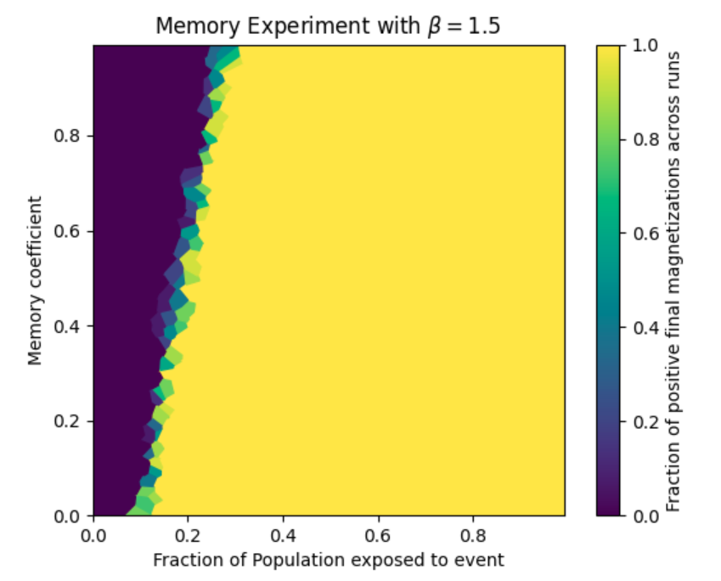
H3: Strong memory within the population limits disinformation spread.
Question: How does an increase in cognitive inertia affect the tipping point of the network?
Conclusion: An increase in the memory coefficient leads to an increase in the necessary fraction required to flip the consensus.
Notes:
Oskar
Now we’re ready to move onto our third and final hypothesis, that a population with high cognitive inertia will be harder to affect by propaganda. The experiment setup is similar to the previous ones, we have the time dependent external field that is an impulse that affects only a fraction of the population, and are interested in the probability of the network pivoting to the pushed belief. However, this time, instead of plotting the temperature parameter, we show the memory coefficient on the vertical axis. We fix the inverse temperature parameter to 1.5, which is also what we saw in the parameter sweep from the GIF before. Other than that the setup is the same - due to time constraints, we consider only the Erdos-Renyi topology.
The results are quite clear: With an increase in the memory coefficient, which makes individuals more attentive to their own previous state, we see the tipping point move up. A population with a high memory coefficient will require a more widespread propaganda effect to be toppled. This was quite a simple conclusion to draw. It is worth noting that we still have quite a sharp transition threshold between recovery and vulnerability, so this transition characteristic is not affected by memory or temperature - but of course we still can’t have too high temperature.

Slide 22
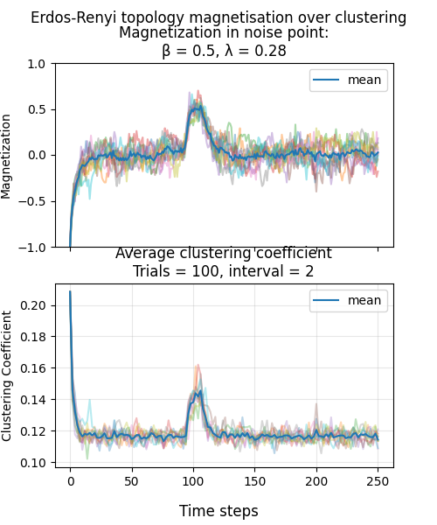
Appendix: Clustering behaviour of Erdos-Renyi
Static topology, but changing connected components
Fraction of neighbouring nodes
which share a belief and edge.
100 trials at each interval for each run
Noisy state
Low inverse temperature
Low degree of average belief clustering
Returns to chaos after an exposure event
Notes:
Oskar
As a little extra and to slightly validate our models behaviour, we calculated and plotted the approximate clustering coefficient for different parameters of the inverse temperature beta and the propaganda nudge lambda.
Since the network topology is static over the span of a run, we approximated belief clustering based on a grouping of belief state.
By sampling random nodes in the network and checking if two of it’s same-belief neighbours also share an edge, the approximate fraction of same belief triangles over non-connected triangles was computed.
Here we found the expected behaviour of a high temperature or chaotic network settling at a low clustering coefficient, which then briefly increases as a fraction of the population is influenced by propaganda. Due to the high temperature of the network, the nodes with their belief adapted by the event, don’t have the coupling strength to pull their neighbours towards this uniform belief state.

Slide 23
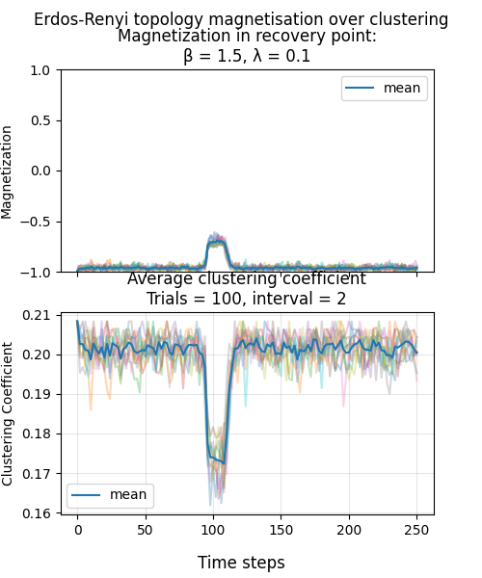
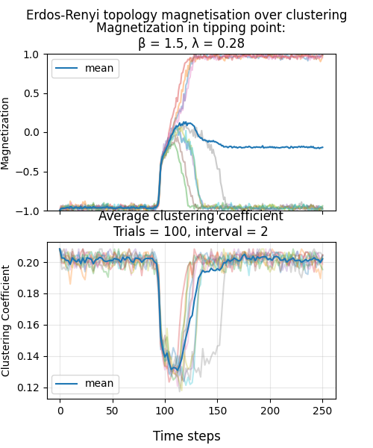
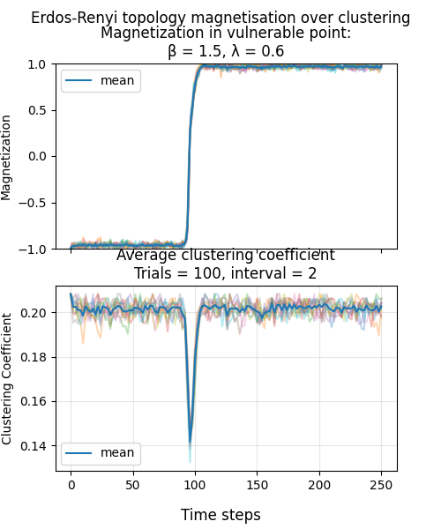
Returns to a stable, high clustering degree, regardless of network-wide belief alignment.
Notes:
Oskar
For lower temperature (higher beta) networks however, we see a higher clustering coefficient, regardless of belief state. Due to overall belief reaching a consensus in the network, existing clusters of connected nodes collectively change in belief state.
The recovery of a high clustering coefficient state does change with the extent of exposure a propaganda event has:
Where a small fraction of population is exposed and the belief consensus returns to a state of negative belief alignment, the coupling between nodes need some time to recover or return to the initial clusters, whereas a large exposed fraction of the population leads to a sudden switch in global belief alignment and the adoption if disinformation from the exposed nodes is sudden and quick through the network.
At the in between fraction of exposed population the clustering coefficient rises more slowly in some runs, due to belief alignment not instantly returning to a bipolar state.
“””brain dump, dont include!!!:”””
what if different runs in the middle plot were to represent different chat groups or social media hubs, where due to their size and structure looking very similar in the initial state of non-existent propaganda, were aligned in the same belief, but show different behaviours in the event of a propaganda nudge? Would be cool or something I guess.

Slide 24
Summary of Findings
There exists a temperature threshold dividing order and chaos states.
The scale-free network is the least resilient to external influence of propaganda ( even a small fraction can convince the rest of the population).
A population with strong cognitive inertia (memory coefficient) is more resilient.
During the propaganda event, the clustering coefficient increases greatly in the high temp regime, but decreases otherwise.
Validation
We cannot validate the model as no such dataset exists.
This is just a model.
Notes:
Oskar
Now to wrap up: 1. By investigtaitng the tipping point, we confirmed there’s a clear line where the system flips from random chaos to synchronized order.
2. Scale-Free Vulnerability - Scale-free networks are by far the easiest to influence. Because of the highly connected hubs, a tiny but outspoken minority can flip the entire population's belief (influencers).
3. Memory Matters - High cognitive inertia acts prevents the network from flipping early. When people weigh their past beliefs, the network becomes much harder to flip.
4. Clustering - Interestingly, clustering spikes during propaganda in high-noise environments but actually drops in stable ones, as the global message overrides local community bonds.
Validation & Limitations 1.The Data Gap: To be honest, we can’t fully validate this model and findings because a dataset that tracks individual memory and belief shifts at this scale simply doesn't exist.
2. Model vs Reality - At the end of the day, this is a model. We’re using simplified model with only a few coefficients to represent something as complicated social media and the influence of peoples beliefs.
However, the takeaway. While this research is a simplification, it’s still a powerful tool for seeing exactly where different network structures are most likely to break under pressure from propaganda.

Slide 25


Recipe for robust network dynamics
Small-world-like topology: The diameter of the network should be ≈ log(N) and you should introduce your friends to each other.
High cognitive inertia: Be loyal to your past beliefs ✨ listen to your heart ✨
Notes:
Theo: To conclude we wanted to wrap up with a nice heartfelt message with our learnings. Take them with a grain of salt.
Here is our recipe for a robust network:
Your network should have a small diameter, on the order of log(N) and you should have quite a high average degree.
Our findings regarding the memory parameter suggest that you should stay loyal to your past beliefs (assuming your existing belief is the correct one, which of course it always is). One deep principle we might have inadvertently rediscovered here is the following:
Listen to your heart <3.
And with that, we are ready to take questions.

Slide 26
Questions
Notes:
Theo

